Slide 1
HOG Feature Extraction and SVM-based
HUMAN DETECTION
Falcuty of
Computer Science
University of Information Technology
Viet Nhat Nguyen - 21520378

Slide 2
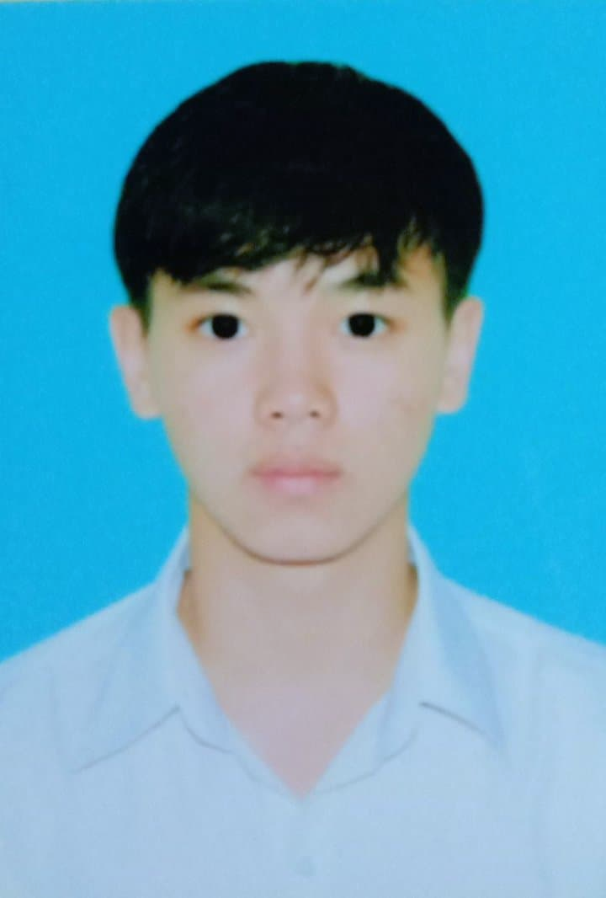
About me
Nhat
21520378@gm.uit.edu.vn
Full name: Viet Nhat Nguyen
UID: 21520378
Course: CS231.N21.KHTN
Passionate: Artificial Intelligence, HOBBIES, PET and 10 point this course

Slide 3
ToC
01
03
Introduction
Implementation
Problem, as well as reasons to solve it
Dataset, metrics and results
02
04
Methodology
Showcase
Overview about object detection chain
Some results of my detector

Slide 4
01
INTRODUCTION
Human Detection

Slide 5
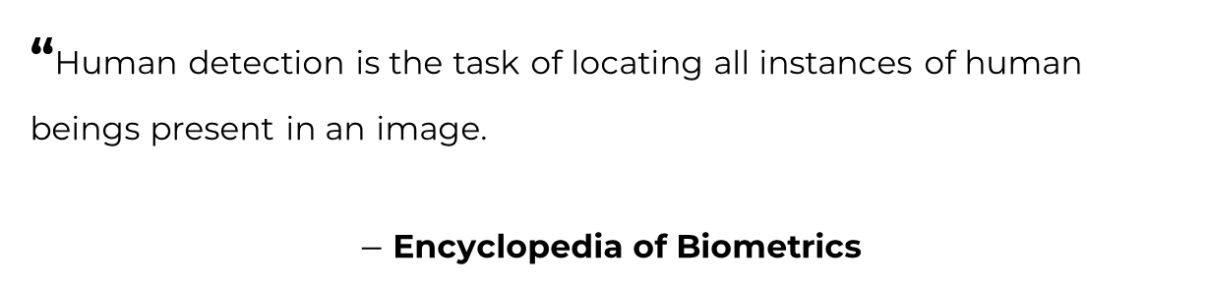
Definition
“Human detection is the task of locating all instances of human beings present in an image.
$−$ Encyclopedia of Biometrics
1

Slide 6
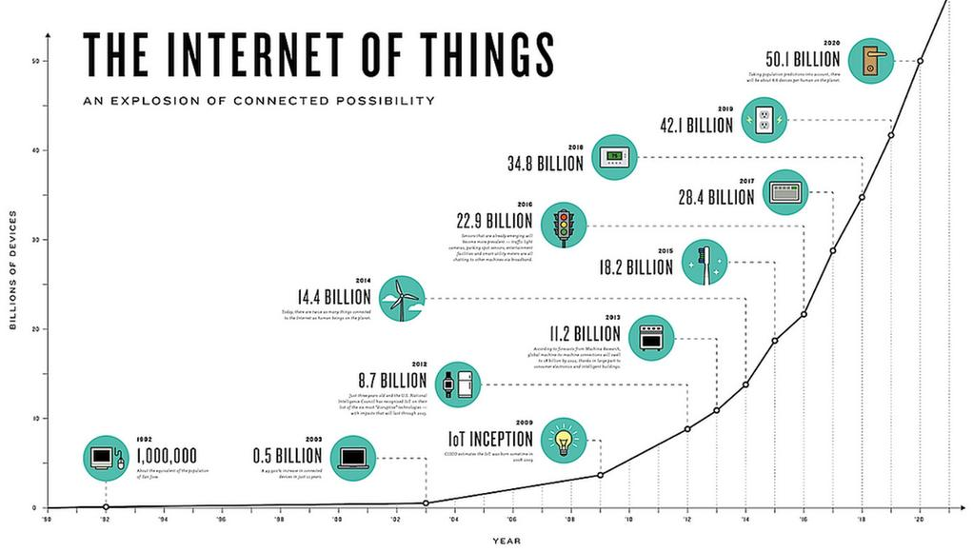

Slide 7
500 hours
Video content uploaded to YouTube every minute
(Tubefilter, 2019)

Slide 8


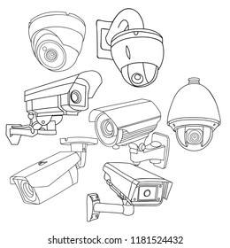



Slide 9
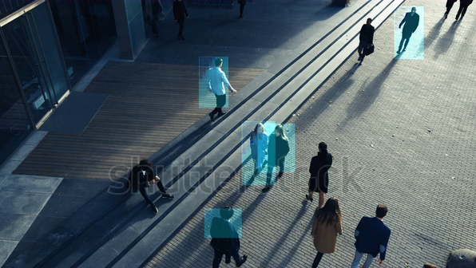
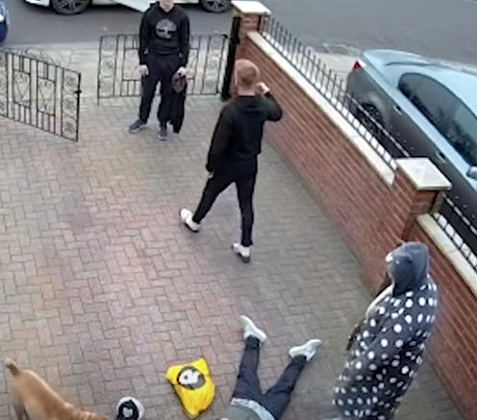
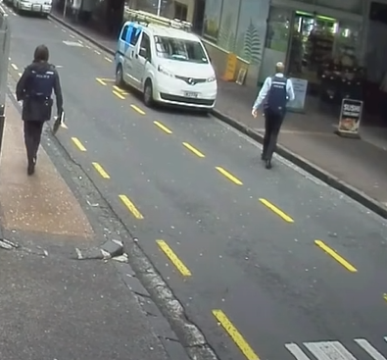
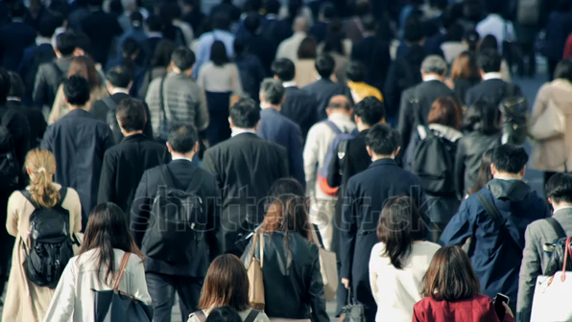
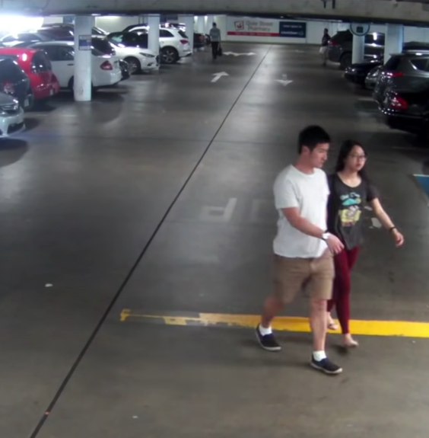
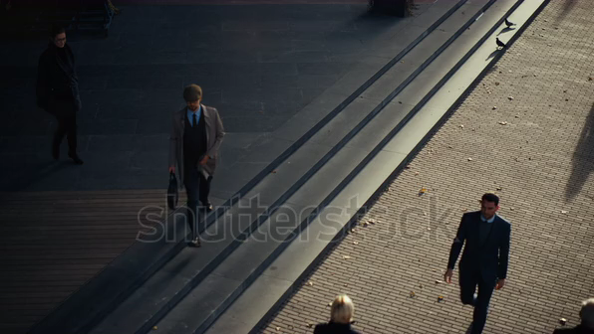
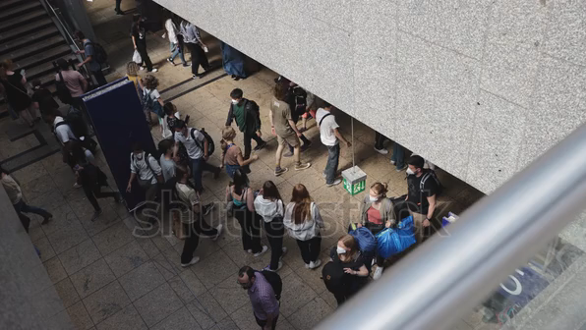
Motivation
Trillion hours of video
The growing emphasis on biometrics and surveillance
Human labor is expensive (and harmful)
The urgency of a computer-aid solution:
Automatic
Persistent (24/7 no-stop)
2

Slide 10
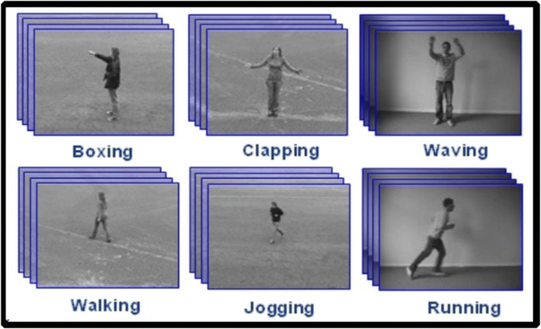
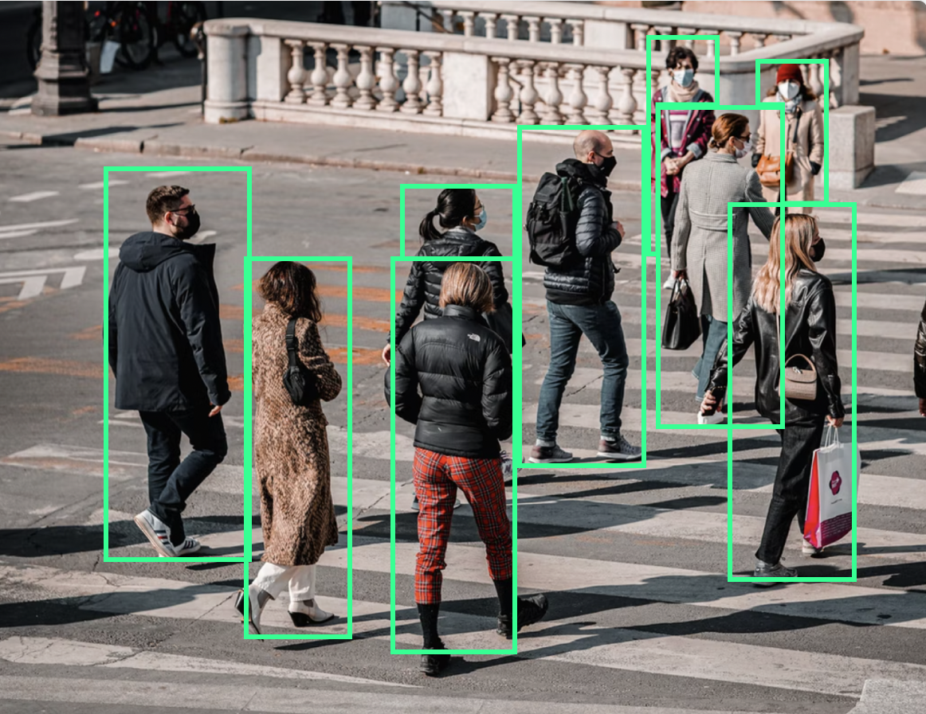
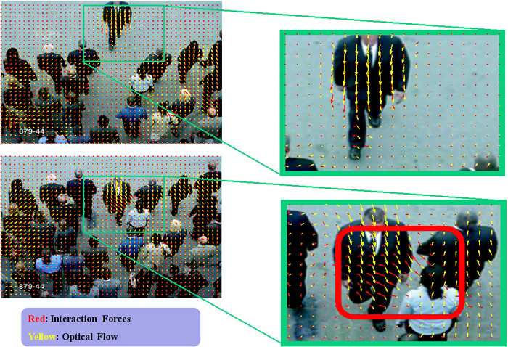
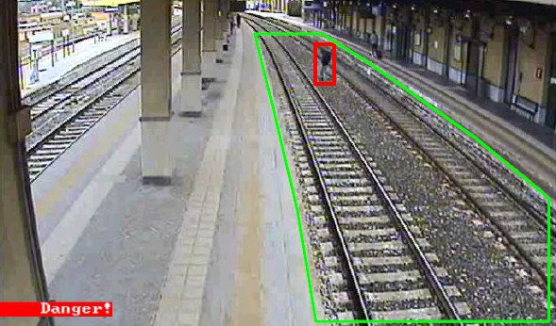
Motivation
Action Recognition
Abnormal Behavior Detection
Human Detection
3
Intrusion Warning

Slide 11
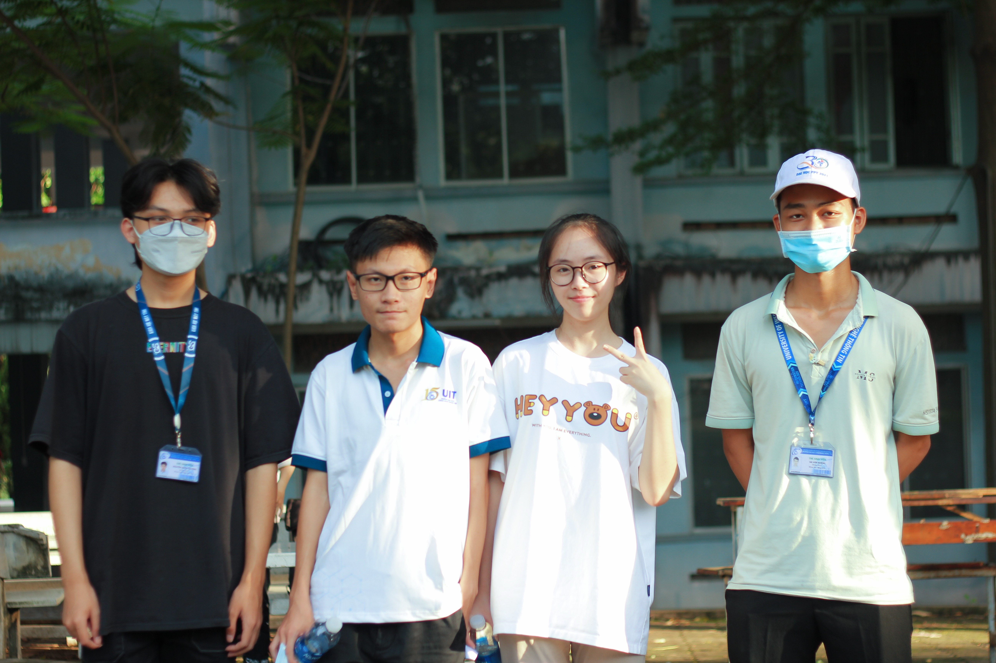
Input
Output
TRAINED MODEL
Image (a frame of video)
Training set
Bounding boxes (x, y, w, h)
Confidence scores
4

Slide 12
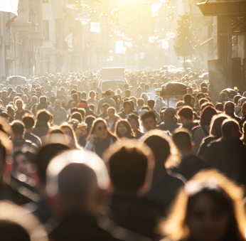
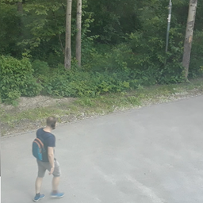
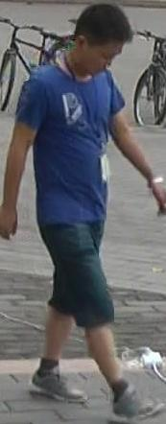
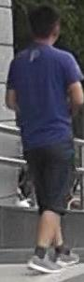
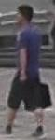
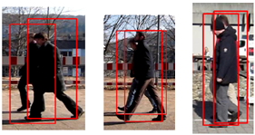

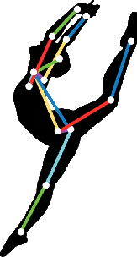
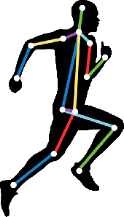
Challenges
Human Detection faces a lot of challenges:
Variability in Appearance
Scale and Perspective Variations
Occlusions
Cluttered Background & Lighting Conditions
Real-time processing
5

Slide 13
02
Methodology
Human Detection using HOG Feature Extraction and Linear SVM

Slide 14

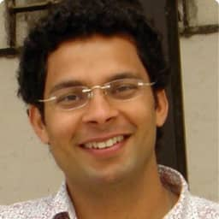
About Method
“Histograms of Oriented Gradients for Human Detection”, IEEE Computer Society Conference on CVPR, 2005
Navneet Dalal, Bill Triggs
6
Bill Triggs
Navneet Dalal

Slide 15
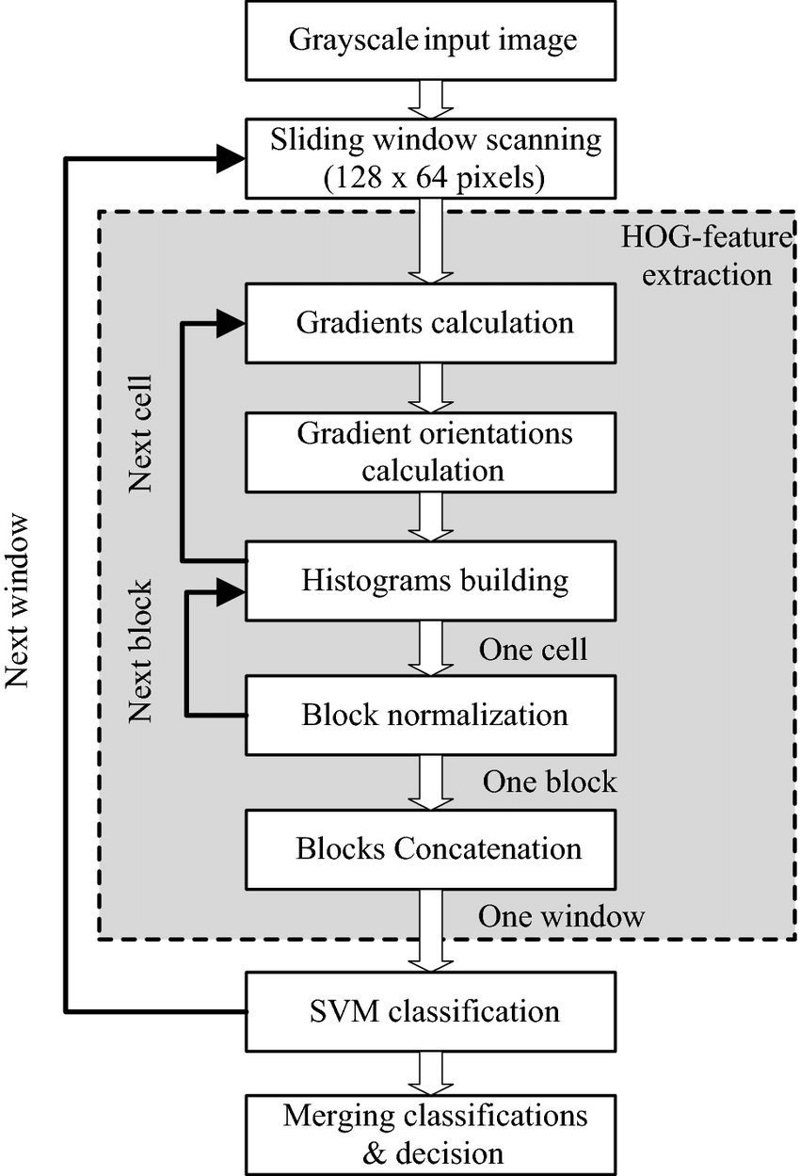
Block Diagram
Pre-processing
HOG Feature Extraction
SVM Classifier

Slide 16
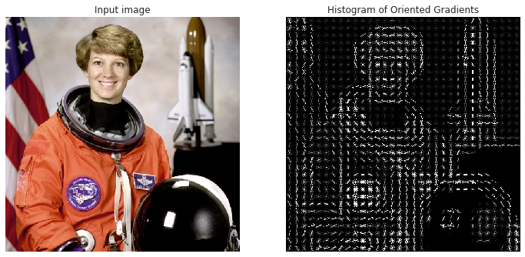
Histograms of Oriented Gradients
Capture important local shape and edge information.
Robust to variations in lighting, contrast, and viewpoint.
Simple to compute and low computational complexity.
7

Slide 17
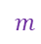
Support Vector Machine
Goal: Finding an optimal hyperplane that best separates different classes of data
$$m$$
Benefits:
Effective in High-Dimensional Space
Versatility in Kernel Functions
Robust to Overfitting
8

Slide 18
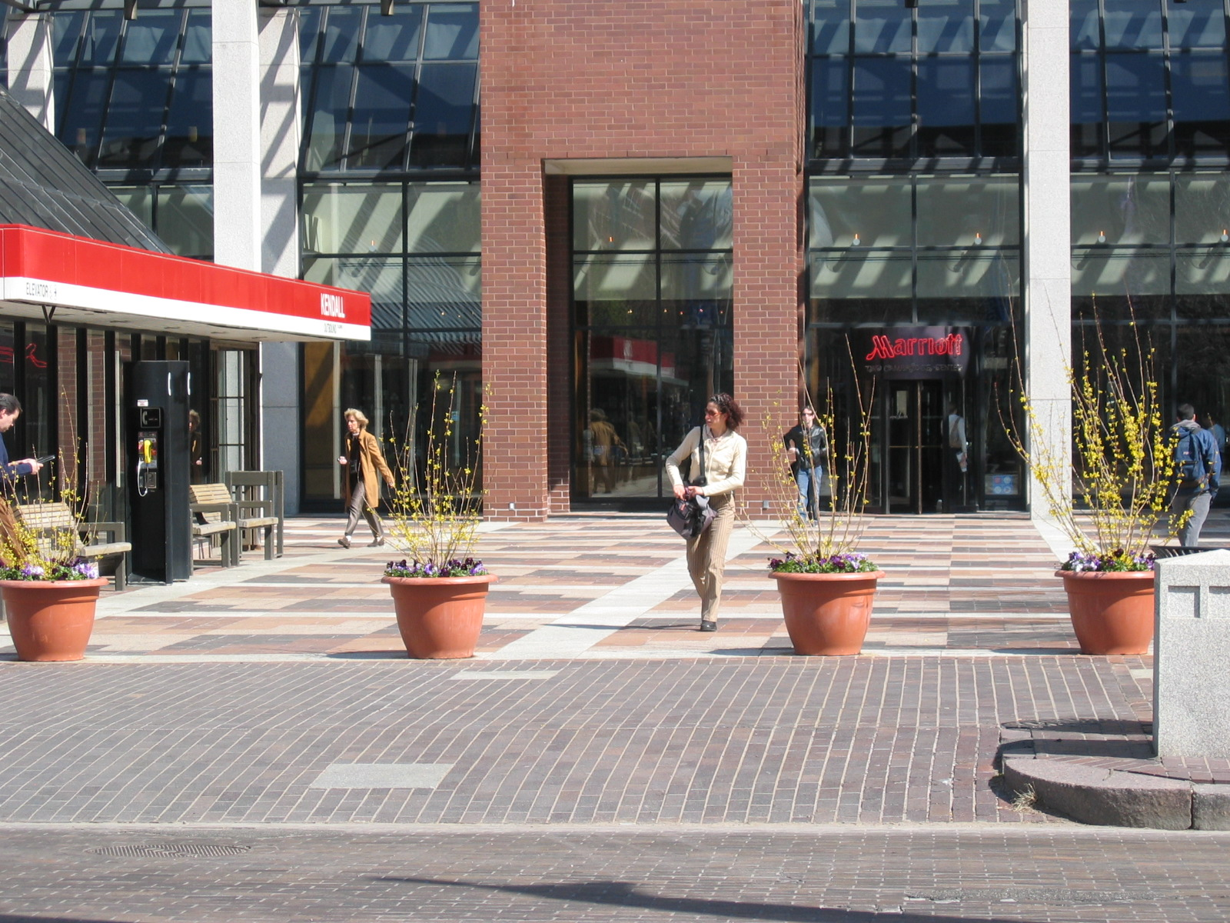
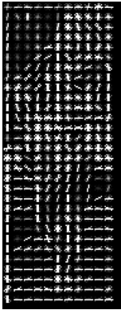
SVM Classifier using HOG Features
Human
Feature
extraction
SVM Classifier
Prediction
Not human
Image
HOG Features
9

Slide 19
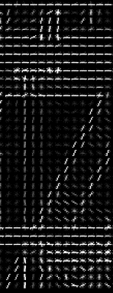
Approach for Human Detection
Feature
extraction
SVM Classifier
Not human
Image
HOG Features
10
Sliding Window

Slide 20
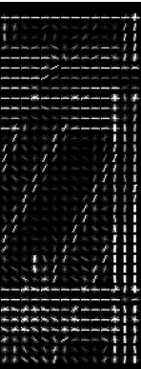
Approach for Human Detection
Feature
extraction
SVM Classifier
Not human
Image
HOG Features
10
Sliding Window

Slide 21
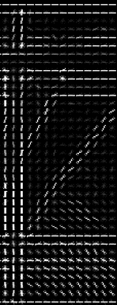
Approach for Human Detection
Feature
extraction
SVM Classifier
Not human
Image
HOG Features
10
Sliding Window

Slide 22
Approach for Human Detection
Feature
extraction
SVM Classifier
Not human
Image
HOG Features
10
Sliding Window

Slide 23
Approach for Human Detection
Feature
extraction
SVM Classifier
Not human
Image
HOG Features
10
Sliding Window

Slide 24
Approach for Human Detection
Feature
extraction
SVM Classifier
Not human
Image
HOG Features
10
Sliding Window

Slide 25
Approach for Human Detection
Feature
extraction
SVM Classifier
Not human
Image
HOG Features
10
Sliding Window

Slide 26
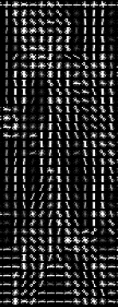
Approach for Human Detection
Human
Feature
extraction
SVM Classifier
Image
HOG Features
10
Sliding Window

Slide 27
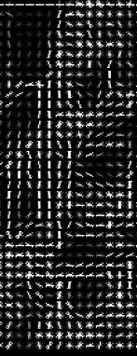
Approach for Human Detection
Feature
extraction
SVM Classifier
Not human
Image
HOG Features
11
Issue

Slide 28
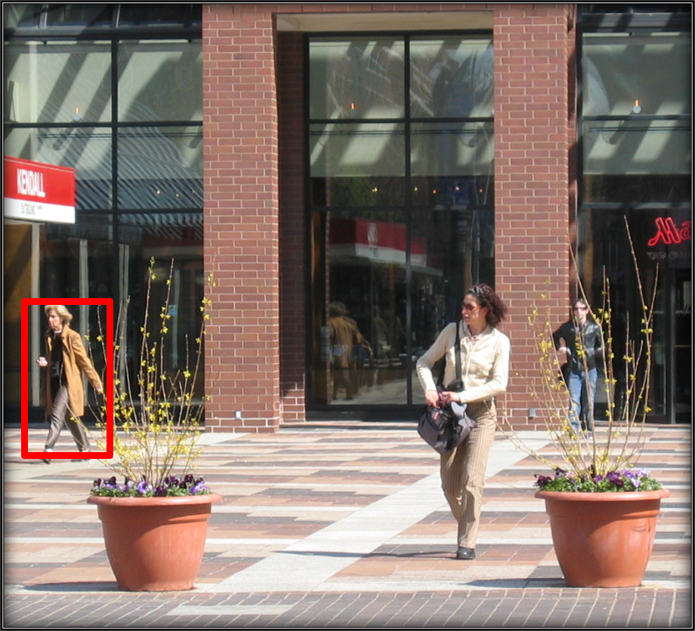
Approach for Human Detection
Image (0.55)
Image (0.70)
Image (0.85)
Image (1.0)
12
Image Pyramid

Slide 29
Approach for Human Detection
Multiple bounding boxes for the same person!
Key concept:
Eliminate redundant and overlapping bounding box predictions.
Select the most confident and accurate bounding box while discarding overlapping and redundant ones.
Image
13
Non-Maximum Suppression

Slide 30

Pipeline
Input
Image Pyramid
Sliding Window
Prediction
Human
Pre-Processing
HOG Features
Extraction
SVM
(Classifier)
Not human
Post-Processing
14

Slide 31
03
Implementation
Datasets, metrics and results

Slide 32
Datasets Selection
Folder Structure:
Images/
├── Train/
│ ├── Pos/
│ └── Neg/
└── Test/
│ ├── SVM/
│ │ ├── Pos/
│ │ └── Neg/
│ └── Detector/
│ ├── Images/
│ └── Annotations/
└── Val/
├── Image/
└── Annotations/
detect.py
train.py
evaluation.py
Datasets:
INRIA Person Dataset (SVM)
VOC 2005 (person) Dataset (Detector )
15

Slide 33
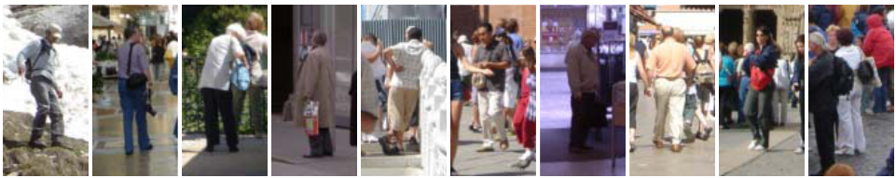
INRIA PERSON DATASET
The subjects are always upright, but with some partial occlusions and wide range of variations in pose, appearance, clothing, illumination and background
16

Slide 34
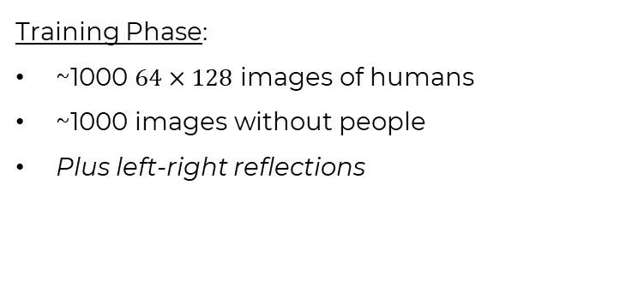
INRIA PERSON DATASET
The subjects are always upright, but with some partial occlusions and wide range of variations in pose, appearance, clothing, illumination and background
Training Phase:
~1000 $64×128$ images of humans
~1000 images without people
Plus left-right reflections
16

Slide 35
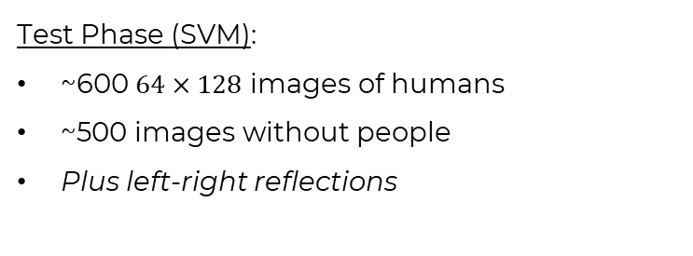
INRIA PERSON DATASET
The subjects are always upright, but with some partial occlusions and wide range of variations in pose, appearance, clothing, illumination and background
Training Phase:
~1000 $64×128$ images of humans
~1000 images without people
Plus left-right reflections
Test Phase (SVM):
~600 $64×128$ images of humans
~500 images without people
Plus left-right reflections
16

Slide 36
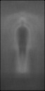
INRIA PERSON DATASET
Cue mainly on silhouette contours
Good for up-right subjects
May not good with sitting, dancing or lying people.
The average gradient image over the training examples
17

Slide 37
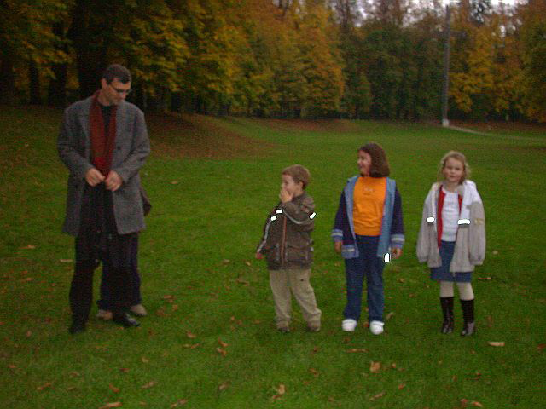
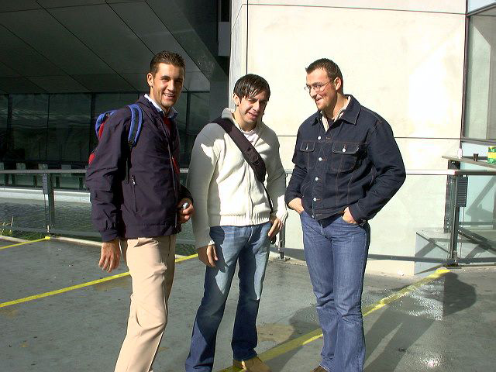
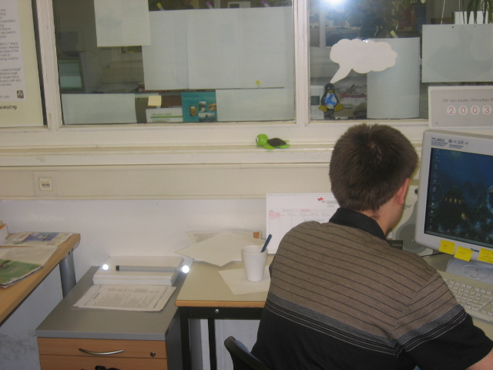
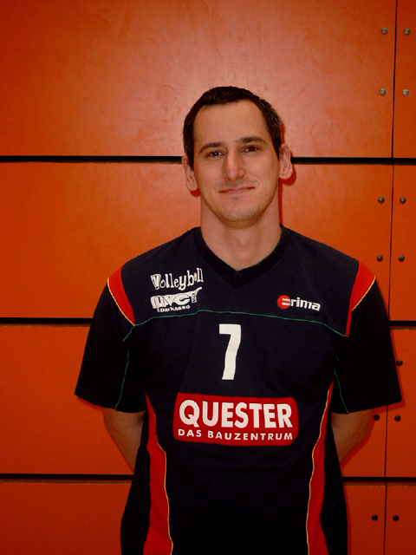
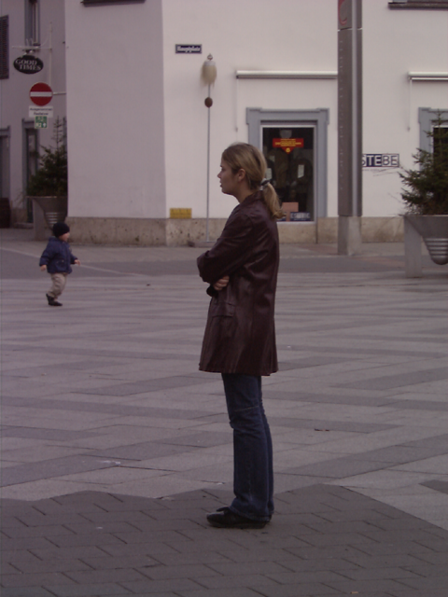
VOC 2005 Dataset
Images:
309 images with variations on poses, scales, occlusions, radiant…
Annotations:
Bounding boxes (x, y, w, h)
Split into Val/ and Test/
1 Val : 2 Test
First 103 items into Val
Last 206 items into Test
18

Slide 38
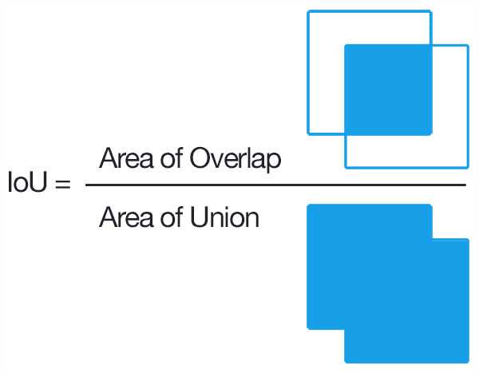
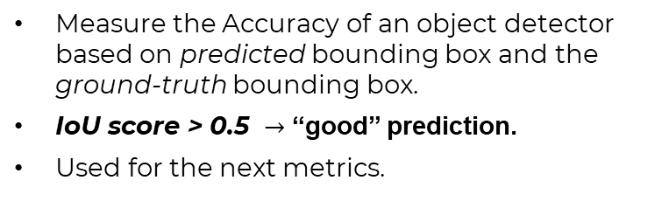
Metrics
Measure the Accuracy of an object detector based on predicted bounding box and the ground-truth bounding box.
IoU score > 0.5 $→$ “good” prediction.
Used for the next metrics.
19
Intersection over Union

Slide 39

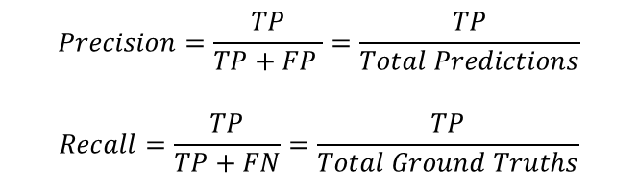
Metrics
$$Precision=\frac{TP}{TP+FP }=\frac{TP}{Total Predictions}$$
$$Recall=\frac{TP}{TP+FN}=\frac{TP}{Total Ground Truths}$$
TP
FP
$$F1_score=2×\frac{Precision×Recall}{Precision+Recall}$$
FN
TN
20
F1-score

Slide 40

Metrics
Widely used metric in binary classification task (the detector only human – not human)
Harmony average of Precision and Recall, which can help to achieve a reliable and robust detection.
$$F1_score=2×\frac{Precision×Recall}{Precision+Recall}$$
21
F1-score

Slide 41
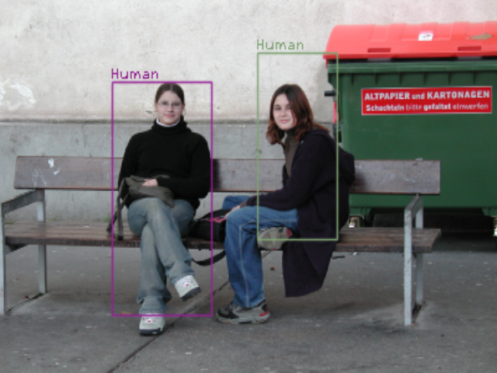
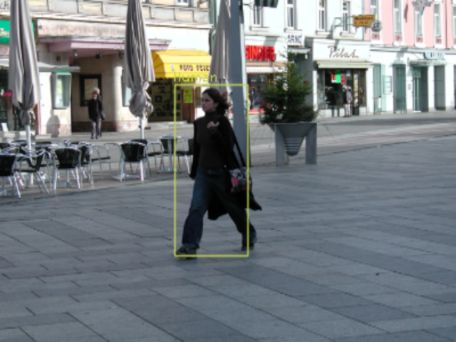






Results
21

Slide 42

Results
22

Slide 43

Results
With confidence_score = 1.8:
Precision: 0.30726256983240224
Recall: 0.22964509394572025
F1-score: 0.2628434886499403
23

Slide 44
04
Showcase
nv259/HumanDectection

Slide 45
Thanks!
Do you have any questions?
nguyenvietnhat.03@gmail.com
+84 362 272 805

